Slide 1

CSE221: Algorithms
Shortest Path Algorithms
Prepared by: A B M Muntasir Rahman [MUNR]

Slide 2
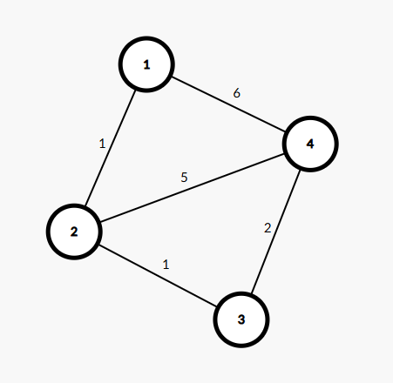
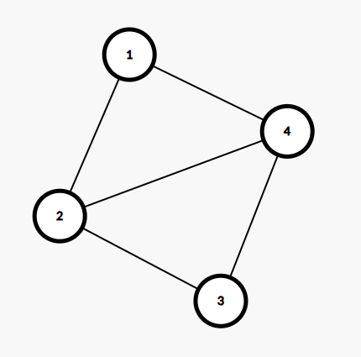
Weighted vs Unweighted Graph
Weighted Graph
Unweighted Graph

Slide 3
Weighted Graph Shortest Path
Let, 1 is source and 4 is destination
Unweighted Shortest Path:
1 -> 4
Weighted Shortest Path:
1 -> 2 -> 3 -> 4

Slide 4
Single Source Shortest Path Problem
We will discuss two general case algorithms:
Dijkstra’s Algorithm (positive weights)
Bellman - Ford Algorithm (positive and negative weights)
However, if the graph has equal weights for all the edges i.e. 1/2/3 so on, the problem can be solved by BFS traversal.

Slide 5
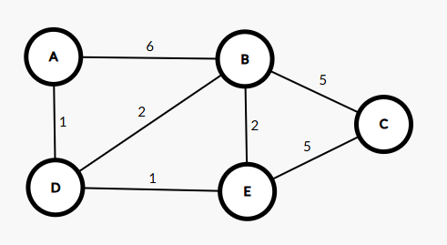
Dijkstra’s Algorithm
Single Source Shortest Path (SSSP) Algorithm i.e. given a source vertex, Dijkstra can find the shortest path and path cost to all the other connected vertices.
Graph can be either directed or undirected.
Must be weighted with positive edge weights.
Similar to BFS.

Slide 6
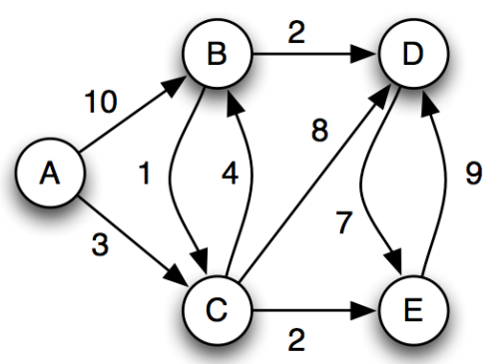
Simulation
Visited
0 | 0 | 0 | 0 | 0
A B C D E
Distance
∞ | ∞ | ∞ | ∞ | ∞
A B C D E
Parent
N | N | N | N | N
A B C D E

Slide 7
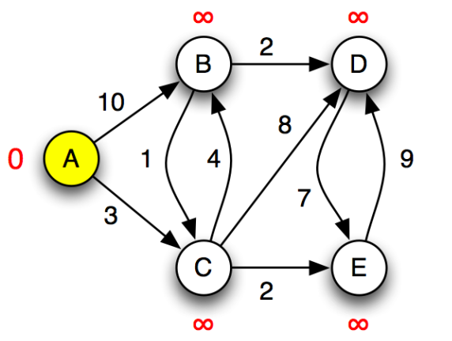
Simulation
Visited
1 | 0 | 0 | 0 | 0
A B C D E
Distance
0 | ∞ | ∞ | ∞ | ∞
A B C D E
Parent
-1 | N | N | N | N
A B C D E

Slide 8
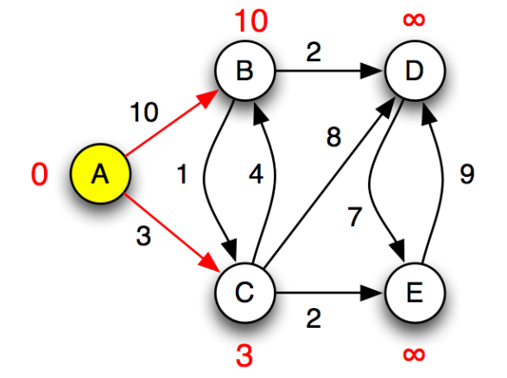
Simulation
Visited
1 | 1 | 1 | 0 | 0
A B C D E
Distance
0 | 10 | 3 | ∞ | ∞
A B C D E
Parent
-1 | A | A | N | N
A B C D E

Slide 9
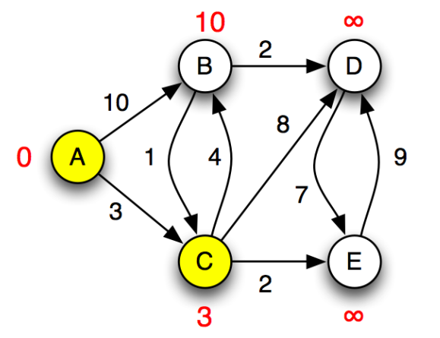
Simulation
Visited
1 | 1 | 1 | 0 | 0
A B C D E
Distance
0 | 10 | 3 | ∞ | ∞
A B C D E
Parent
-1 | A | A | N | N
A B C D E

Slide 10
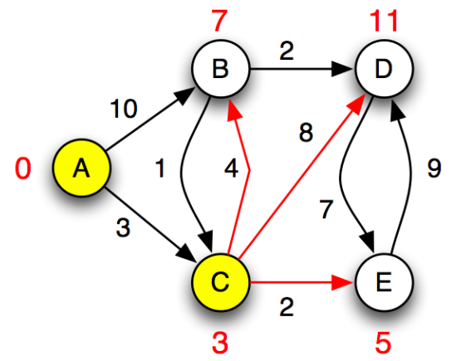
Simulation
Visited
1 | 1 | 1 | 1 | 1
A B C D E
Distance
0 | 10 7 | 3 | ∞ 11 | ∞ 5
A B C D E
Parent
-1 | A C | A | N C | N C
A B C D E

Slide 11
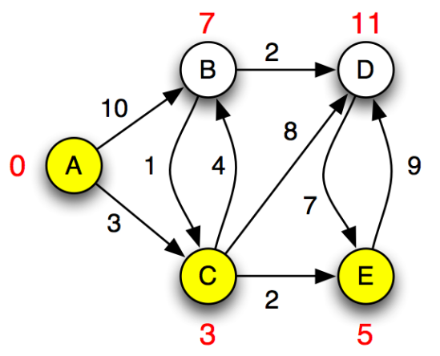
Simulation
Visited
1 | 1 | 1 | 1 | 1
A B C D E
Distance
0 | 10 7 | 3 | ∞ 11 | ∞ 5
A B C D E
Parent
-1 | A C | A | N C | N C
A B C D E

Slide 12
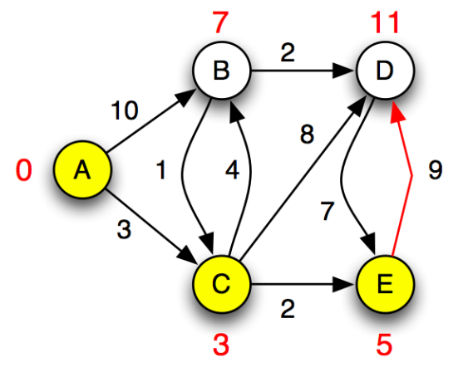
Simulation
Visited
1 | 1 | 1 | 1 | 1
A B C D E
Distance
0 | 10 7 | 3 | ∞ 11 | ∞ 5
A B C D E
Parent
-1 | A C | A | N C | N C
A B C D E

Slide 13
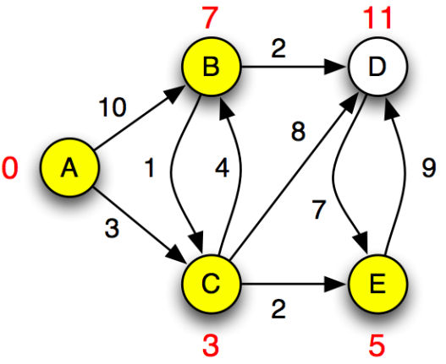
Simulation
Visited
1 | 1 | 1 | 1 | 1
A B C D E
Distance
0 | 10 7 | 3 | ∞ 11 | ∞ 5
A B C D E
Parent
-1 | A C | A | N C | N C
A B C D E

Slide 14
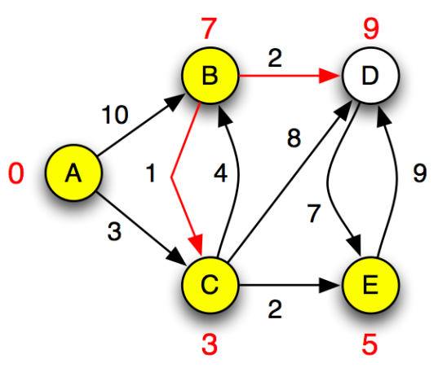
Simulation
Visited
1 | 1 | 1 | 1 | 1
A B C D E
Distance
0 | 10 7 | 3 | ∞ 11 9 | ∞ 5
A B C D E
Parent
-1 | A C | A | N C B | N C
A B C D E

Slide 15
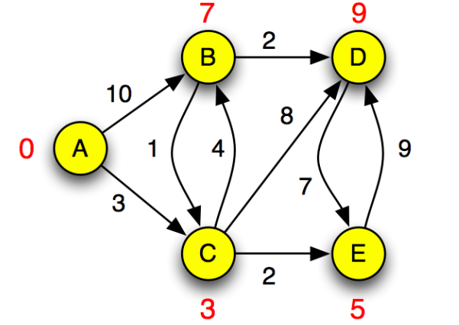
Simulation
Visited
1 | 1 | 1 | 1 | 1
A B C D E
Distance
0 | 10 7 | 3 | ∞ 11 9 | ∞ 5
A B C D E
Parent
-1 | A C | A | N C B | N C
A B C D E

Slide 16
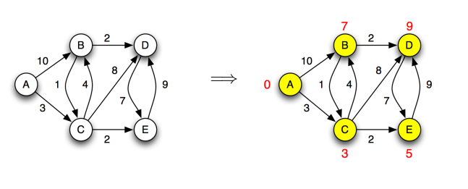
Simulation

Slide 17
Simulation
Visited
1 | 1 | 1 | 1 | 1
What is the shortest distance between A to E?
Ans: Go to index E of distance array (5)
What is the shortest path from A to E?
Ans: Go to index E of parent array (C). Since C is
not source, go to index C (A). Since A is the source,
path will be A -> C -> E.
A B C D E
Distance
0 | 7 | 3 | 9 | 5
A B C D E
Parent
-1 | C | A | B | C
A B C D E

Slide 18
Pseudocode
Dijkstra(G, s)
PQ = empty min-priority queue, parent = [], d = []
for each v in V[G]
d[v] = ∞
parent[v] = null
d[s] = 0
PQ.insert(0, s)
while PQ is not empty:
dist_u, u = extract_min(PQ)
for each vertex v Є Adj[u]:
if d[v] > d[u] + w(u, v):
d[v] = d[u] + w(u, v)
parent[v] = u
PQ.insert(d[v], v)
Relaxation of vertex v

Slide 19
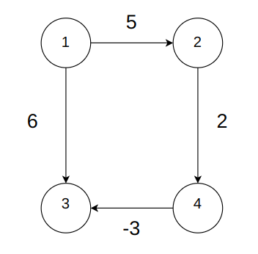
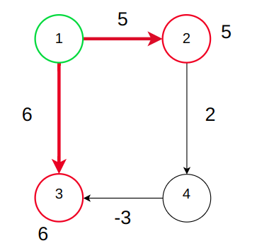
Approach
Dijkstra follows the Greedy Approach to find the shortest path in a weighted graph. At every step of the solution, Dijkstra algorithm picks the vertices with the minimum distance from the source vertex (i.e. greedy choice).
Starting from source vertex 1,
both the edges (1, 2) and (1, 3) will be relaxed. Distance of vertex 2 will be 5 and distance of vertex 3 will be 6. For next step, Dijkstra will choose vertex 2 as it has the minimum distance (i.e. greedy approach)

Slide 20
Limitations of Dijkstra
Might fail in case of negative weights present in the graph, greedy choice can be invalid!

Slide 21
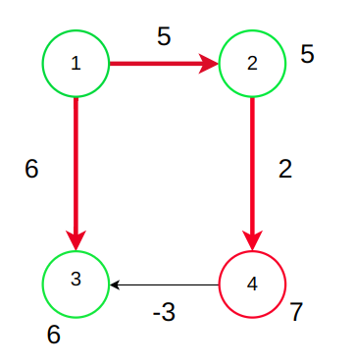
Limitations of Dijkstra
Dijkstra will relax this vertex however, 3 is already processed. Solution? Bellman - Ford Algorithm!

Slide 22
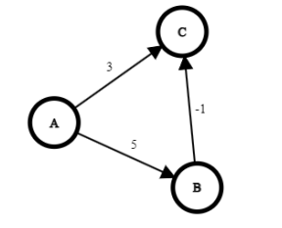
Limitations of Dijkstra
For the below graph, Dijkstra will be able to find the shortest path given A as source even though negative weight is present.

Slide 23
Properties
Time Complexity: O((V+E) log V) using Min-Heap based Priority Queue
  However, if array / list implementation is used for Priority Queue, it is O(V²) (where V = number of vertices).
Space Complexity: O(V)
  However, if graph representation is taken in consideration, it is O(V+E).
Follows greedy approach.
Works on directed and undirected graphs.
If the graph is not connected, it will not be able to visit all vertices.
Does not work if negative weights are present in the graph (except some exceptions).

Slide 24
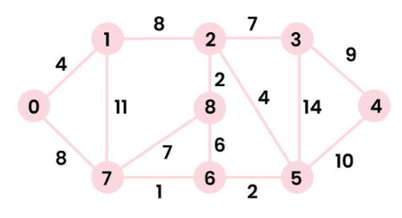
Practice
What is the shortest path and path distance from 1 to 4?

Slide 25
Reference
Graph Algorithms by Mumit Khan
https://drive.google.com/file/d/1MCbK6w6tSITZ3UrV9Na4-tPTolKXjO3D/view?usp=sharing

